Slide 1
Addressing Pain Points in Healthcare
Challenges, Remedies, and Emergency Levels

Slide 2
Introduction
Healthcare faces some big challenges,
not enough access to care,
communication problems,
high costs,
pain treatment issues, and a
lack of emotional support.
Solving these problems is important to make healthcare better for everyone. In this presentation, we’ll look at these challenges and discuss possible solutions and helpful research.

Slide 3
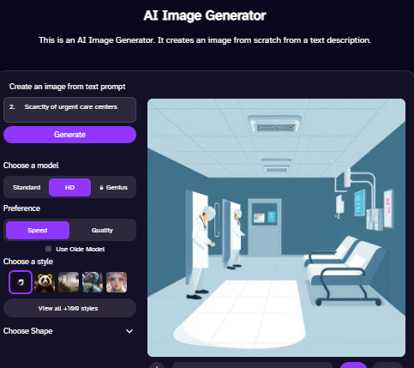
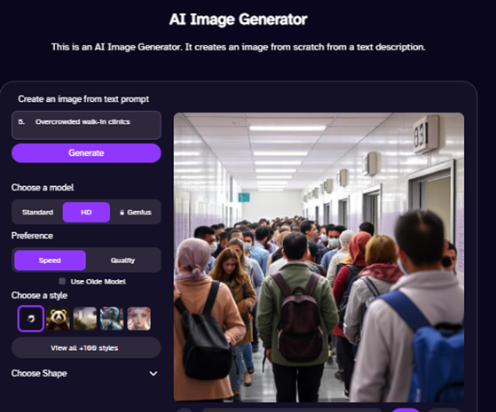
Access to Healthcare
Due to insufficient medical service provisions isolated regions struggle to provide care during nighttime and weekend hours for their patients. Better public transportation services and telemedical care at walk-in centers would enhance patient access to medical care while simultaneously lowering wait times.

Slide 4
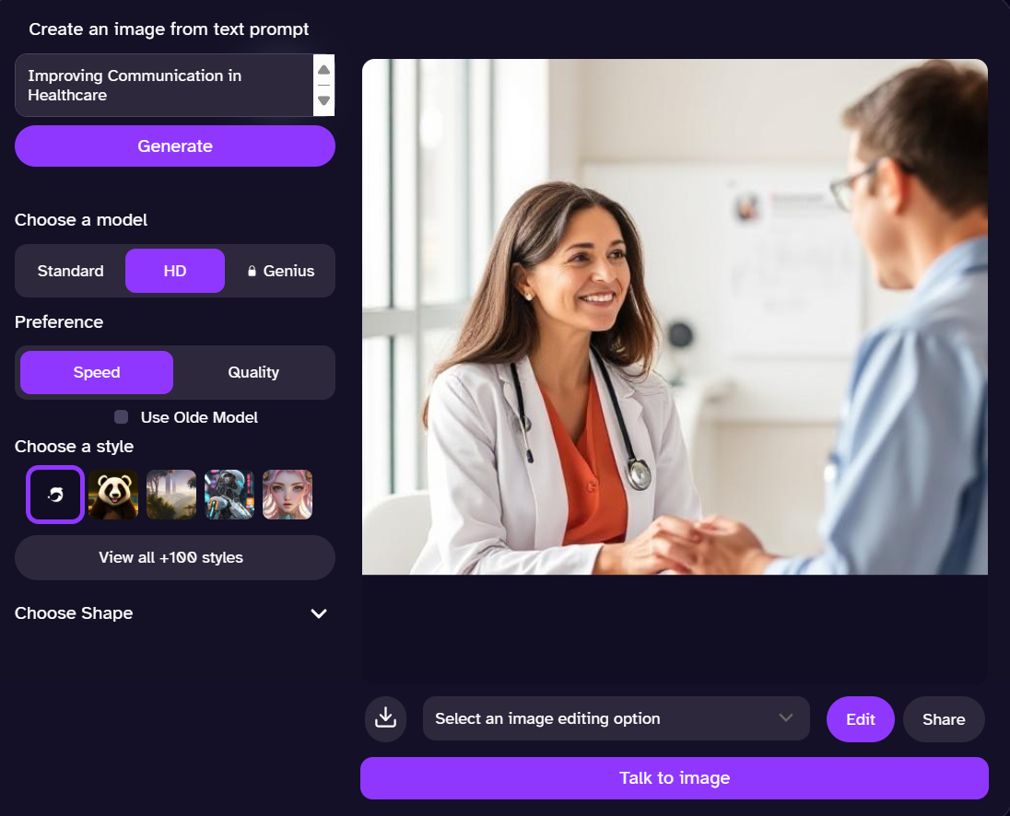
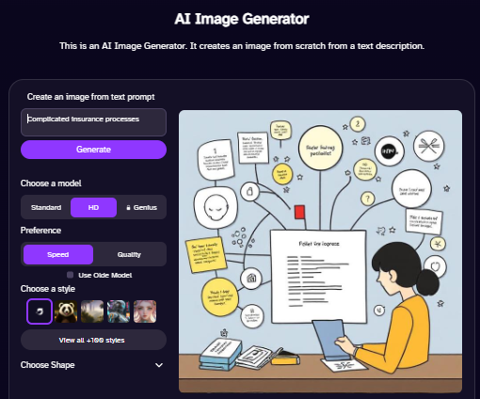
Improving Communication in Healthcare
Medical words are hard to understand. Patients don’t always know what treatments they have. Using simple words, explaining choices clearly, and providing written instructions can help. Bilingual staff and more time with doctors improve communication.

Slide 5
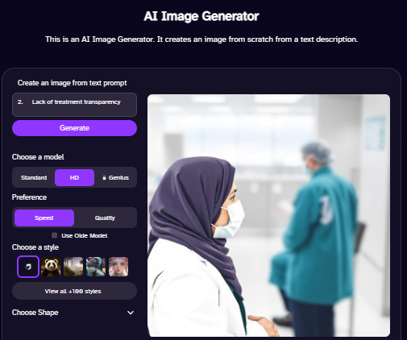
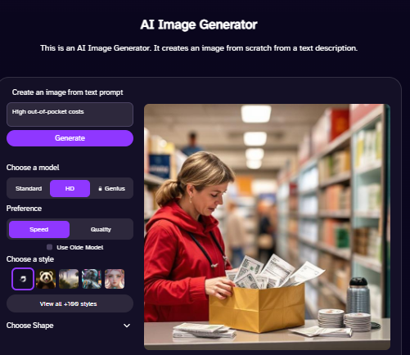
Addressing Financial Barriers High costs and confusing insurance stop people from getting care. Showing prices, helping with insurance, and offering financial help can make healthcare easier to afford.

Slide 6
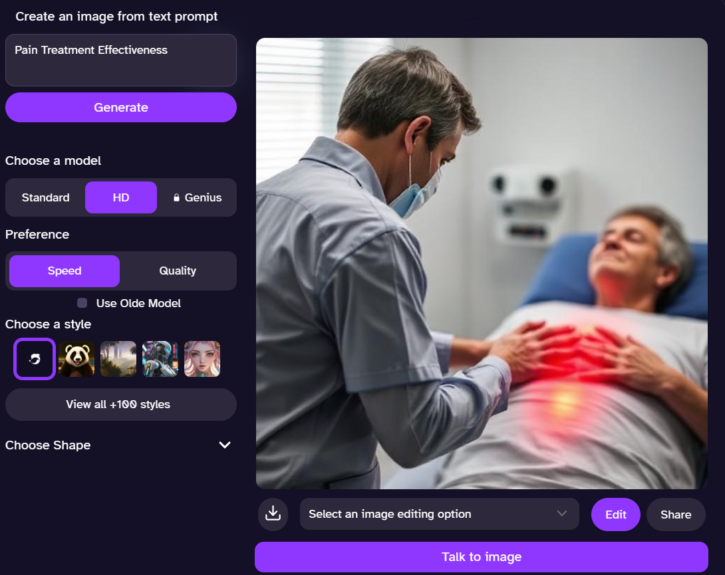
Pain Treatment Effectiveness Recovery takes time, and chronic pain is hard to manage. More therapy, other treatments like acupuncture, and quicker care can help reduce pain and speed up recovery.

Slide 7
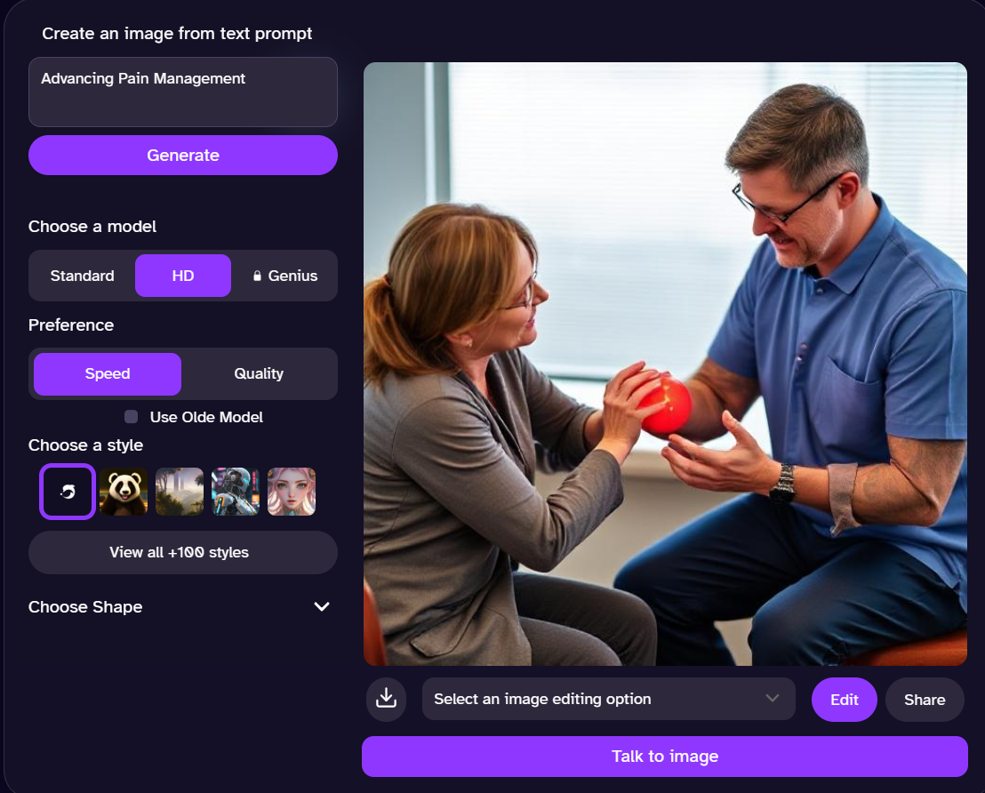
Advancing Pain Management Patients frequently report issues regarding pain management alongside slow services and side effects as well as wrong diagnoses. Current healthcare requires better methods of treatment along with increased workforce numbers and enhanced medication tracking systems. The utilization of holistic treatments results in a 25% reduction of opioid consumption.

Slide 8
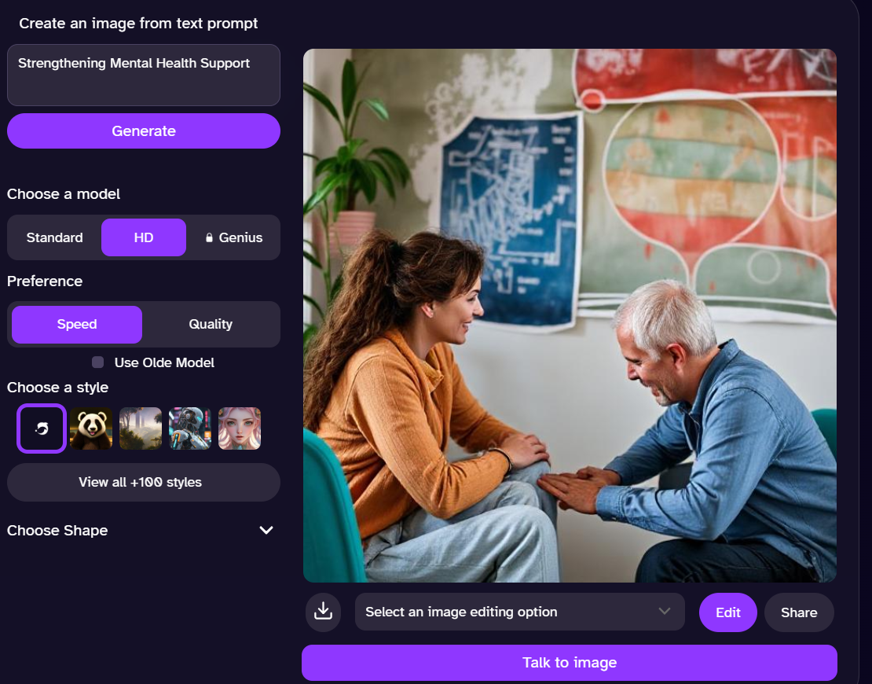
Strengthening Mental Health Support
Active duty military members suffer negative effects when their anxiety medical problems interact with their stress symptoms and depression combined with inadequate mental health care. Military personnel require foundational training both about compassionate care standards and proper mental health service delivery methods. Better quality health care increases by 30% when health institutions establish mental health support services.

Slide 9
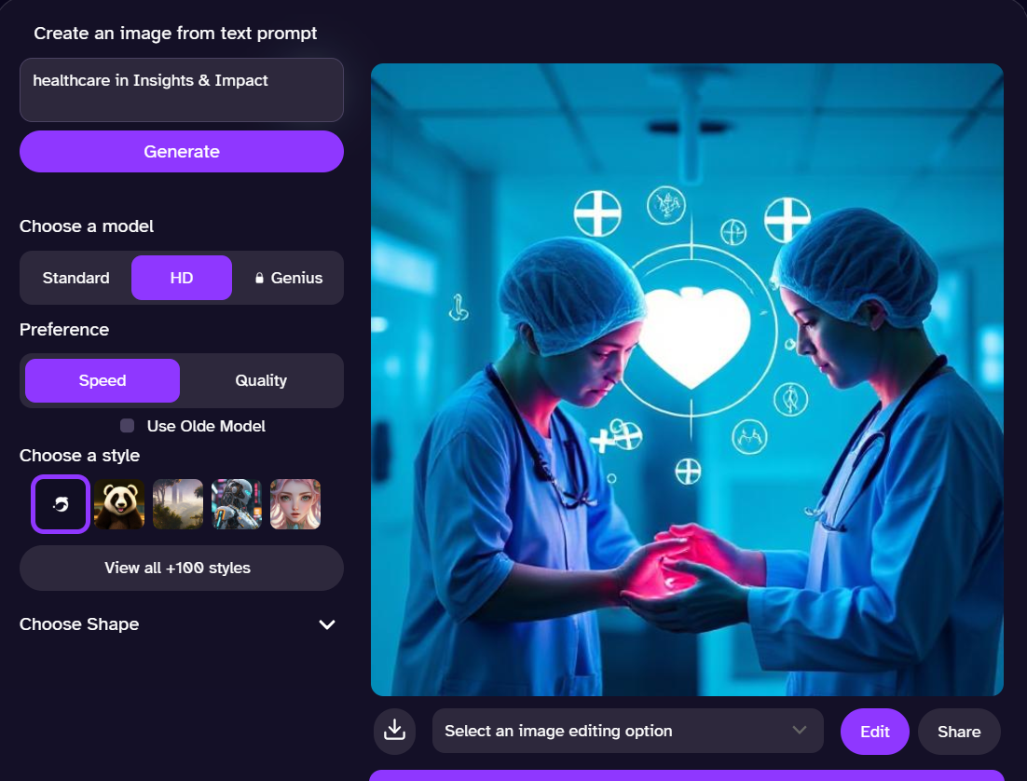
Insights & Impact Telemedicine services implemented in rural locations work together with medical opioids that lead to dependency breakdown in 20-25% of patients. Telemedicine implements early medical services to create strong patient-doctor bonds by ensuring complete patient understanding from the start.

Slide 10
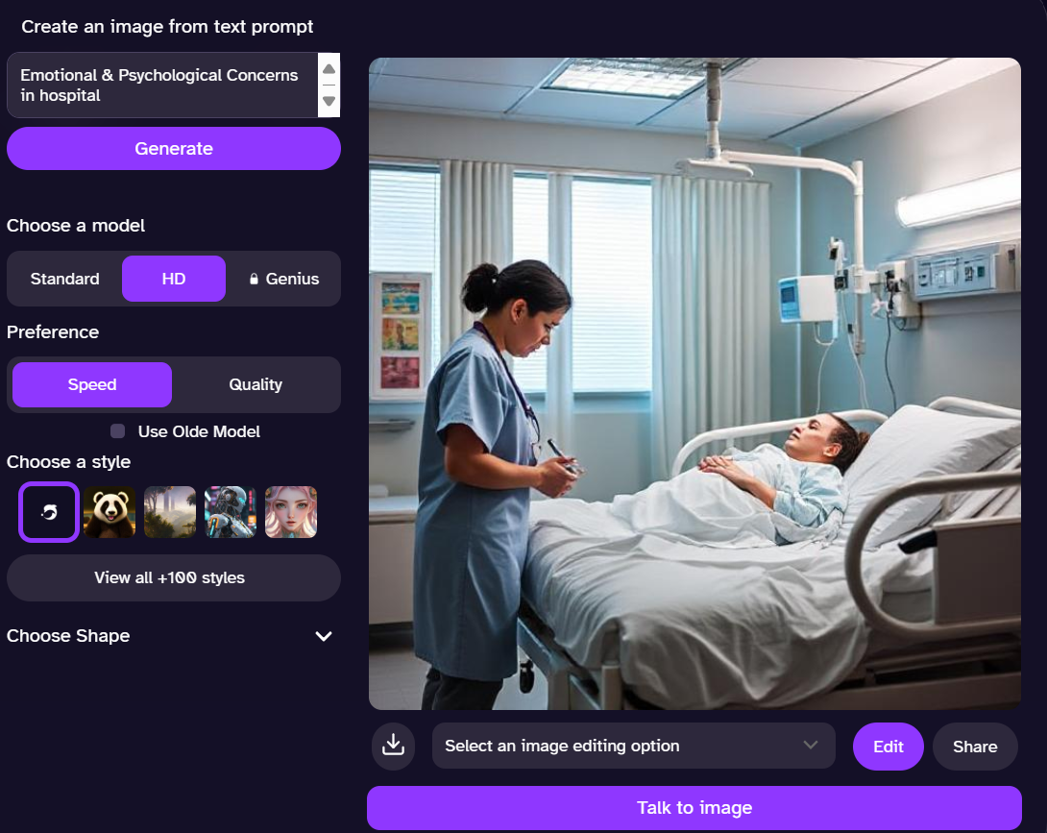
Emotional & Psychological Concerns The majority of patients experience both anxious feelings and sadness. Patients who receive mental health assistance along with caring physicians and counseling professionals tend to recover emotionally while also improving their health conditions.
https://github.com/jagdishkumarhembrom/sign-language-translator.git
Thank you

